Slide 1
Employee Data Analysis using Excel
STUDENT NAME:MONIKA.K
REGISTER NO:312216997
DEPARTMENT:B.COM (GENERAL)
COLLEGE:SHRI KRISHNASWAMY COLLEGE FOR WOMEN

Slide 2
PROJECT TITLE
USING PIVOT TABLET FOR EMPLOYEE TURNOVER ANALYSIS

Slide 3


AGENDA
Problem Statement
Project Overview
End Users
Our Solution and Proposition
Dataset Description
Modelling Approach
Results and Discussion
Conclusion
3/21/2024 Annual Review

Slide 4

PROBLEM STATEMENT
1. Data Collection
2. Data Organization
3. Creating the Pivot Table
4. Analysis
5. Insights and Recommendations
6. Visualization

Slide 5

PROJECT OVERVIEW
Objective
Data Requirements
Data Preparation
Pivot Table Setup
Analysis Methods
Insights Extraction
Reporting and Presentation
Recommendations
.

Slide 6

WHO ARE THE END USERS?
1. HR Managers
2. Data Analysts
3. Department Heads
4. Executives
5. Recruitment Specialists

Slide 7

OUR SOLUTION AND ITS VALUE PROPOSITION
1. Comprehensive Turnover Insights
2. Real-Time Data Analysis
3. Customizable Reporting
4. Trend Identification
5. Data-Driven Decision Making
6. Improved Retention Strategies

Slide 8
Dataset Description
1. Employee ID
2. Hire Date
3. Termination Date
4. Department
5. Job Title
6. Reason for Leaving
7. Tenure
8. Employment Status

Slide 9

THE "WOW" IN OUR SOLUTION
1. Dynamic Data Filtering
2. Real-Time Trend Analysis
3. Interactive Visualizations
4. Automated Reporting
5. Customizable Metrics
6. Cross-Department Comparisons
3/21/2024 Annual Review
9

Slide 10
MODELLING
1. Data Aggregation
2. Turnover Rate Calculation
3. Trend Analysis
4. Departmental Segmentation
5. Benchmarking
6. Predictive Analysis
10

Slide 11
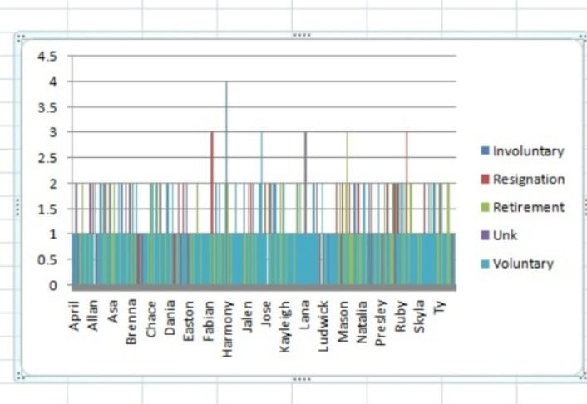
RESULTS
11

Slide 12
conclusion
1. Summary of Findings
2. Impact on HR Strategy
3. Recommendations for Improvement
4. Future Monitoring Plans
5. Overall Value of Pivot Table Analysis

